Slide 1
Semester Project
Submitted by:
Muhammad Hasnat Fakhar(232436)
Muhammad Usman Aslam(232502)
BSCS-ev-F23-2C

Slide 2
Introduction
The project we have made for the semester project is GYM MANAGEMENT SYSTEM.
Well, the in this project front end and back end are both designed.
In this project user can register, login and can do other activities.
Moreover, the admin has control over the whole site to functionalities.

Slide 3
Purpose
Gym Management System serves as several function for both the user and the admin primarily aimed at the user management and business optimization.
Administrative Efficiency: Generally, in these systems aim to simplify administrative tasks, reduce paperwork, and improve overall operational efficiency for gym owners and staff.

Slide 4
Targeted Audience
The targeted audience for the following project are as follow:
GYM OWNER: The owner need the tool to manage memberships, payments, and to run their business efficiently.
MEMBERS: The other targeted audience are the members of the gym, as they can register, avail packages, get details about the packages easily and remotely.
ADMINISTRATIVE STAFF: The administration staff requires comprehensive tool to manage, generate and analyze all the operations of the gym.

Slide 5
Languages And Software
HTML
CSS
JAVASCRIPT
PHP(backend)
XAMPP( to connect and run the database system and the website at a same time)
MYSQL(For SQL )

Slide 6
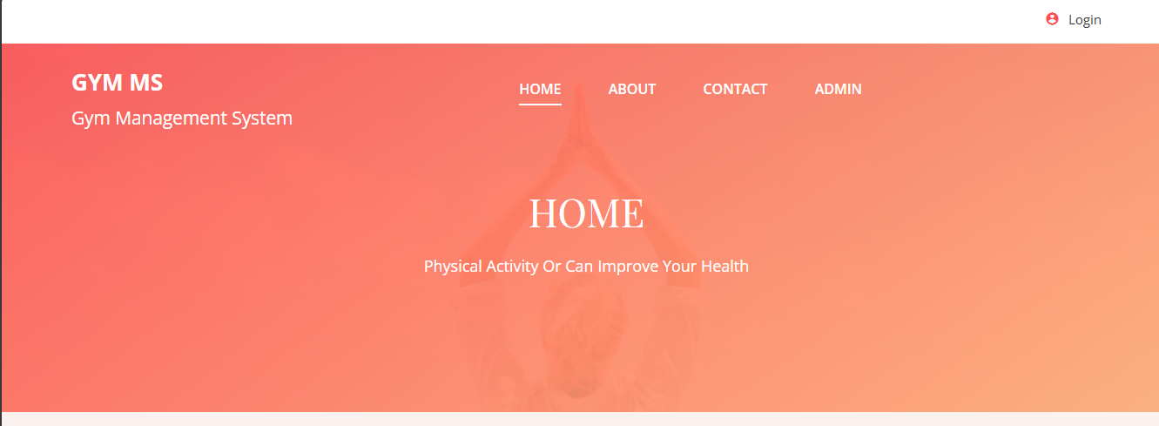
Website Layout and functionalities

Slide 7
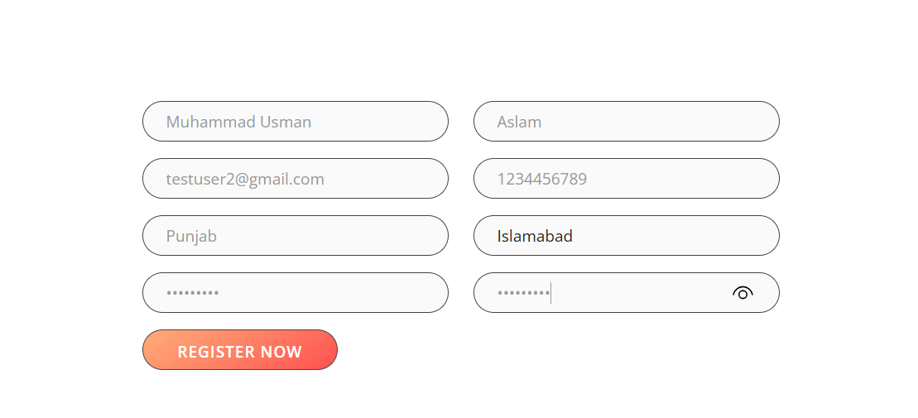
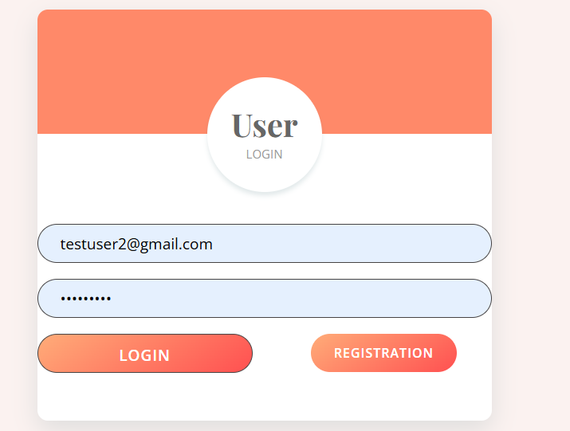
USER PROTAL

Slide 8
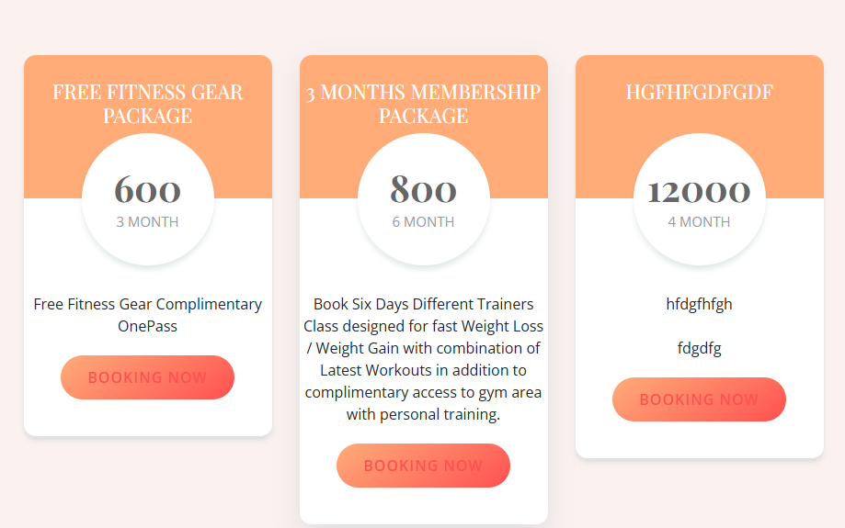
PACKAGES & DETAILS

Slide 9
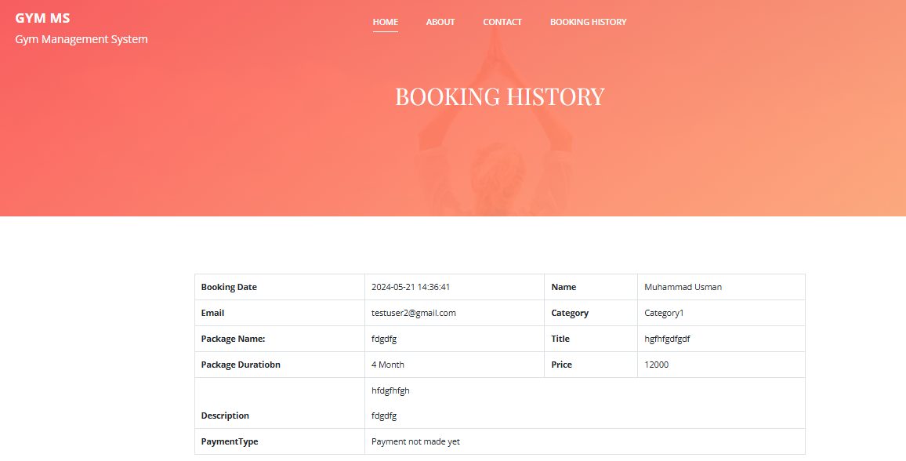
User can also checked the details of his packages of gym and also

Slide 10
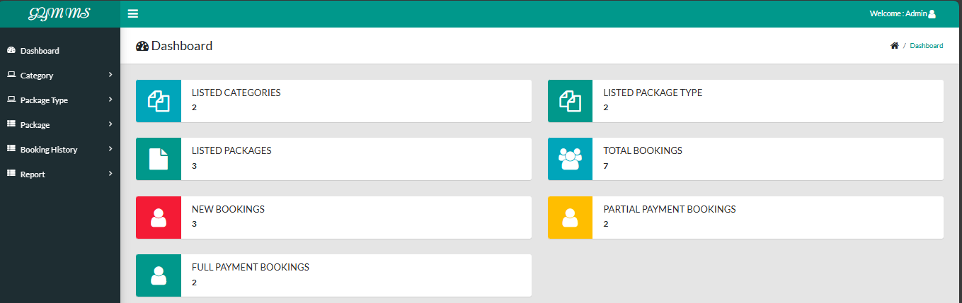
ADMIN PORTAL

Slide 11
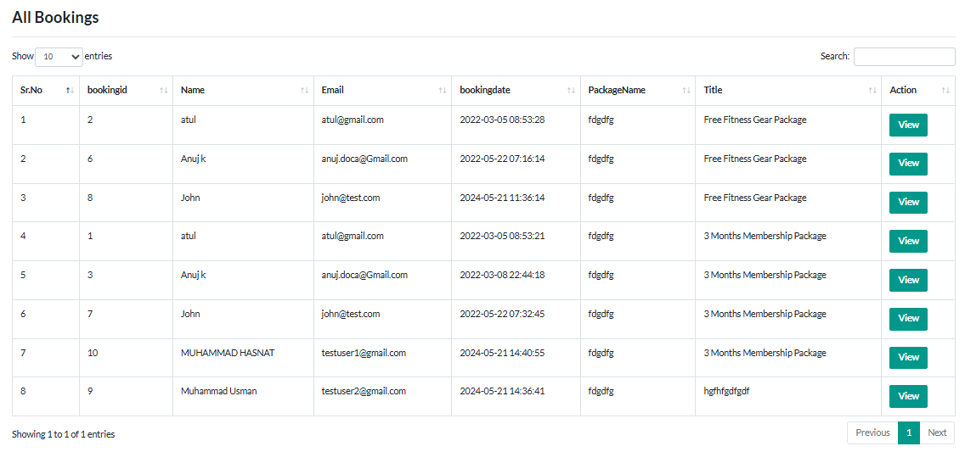
DATABASE OF MEMBERS

Slide 12
THANK YOU!

